Slide 1
UK Hospital Data Analysis
A Comprehensive Exploration of Hospital Data Using Python, Excel, and Power BI

Slide 2
Introduction
This analysis explores hospital data, focusing on hospital types, location, public/private sectors, and organizational structure to inform healthcare understanding.

Slide 3
Table of contents
Data Cleaning & Preprocessing
Exploratory Data Analysis (EDA)
Advanced Data Analysis
Objective
Tools
Dashboard
Strategic Recommendations

Slide 4
Objectives
Clean and preprocess the raw hospital data to ensure data quality and consistency.
Explore the distribution of hospitals by type and subtype to understand the composition of healthcare facilities.
Visualize the geographical distribution of hospitals to identify regional patterns and potential disparities.
Determine the distribution of hospitals between the public (NHS Sector) and private (Independent Sector).
Analyze the influence of parent organizations on hospital distribution.
Assess the completeness of contact information for hospitals.
Examine the density of hospitals across latitude and longitude coordinates.

Slide 5




Tools
Jupyter Notebook
Power BI
Excel
Python

Slide 6
Data Cleaning & Preprocessing
Handle Missing Values
Import Libraries and Load Data
Check for Missing Values
Check for Duplicates and Remove Them
Standardize Phone and Website Formats
Save the cleaned data

Slide 7
Import Libraries and Load Data
Import libraries such as Pandas, NumPy, and Matplotlib to facilitate data manipulation, numerical operations, and visualization respectively. Load the hospital dataset using Pandas' read_csv function to create a DataFrame for analysis.

Slide 8
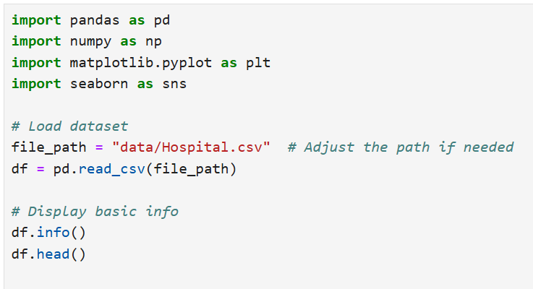

Slide 9
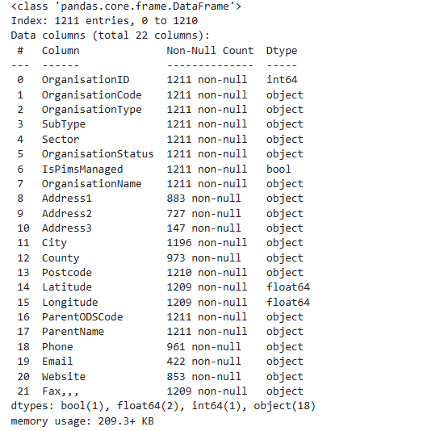

Slide 11
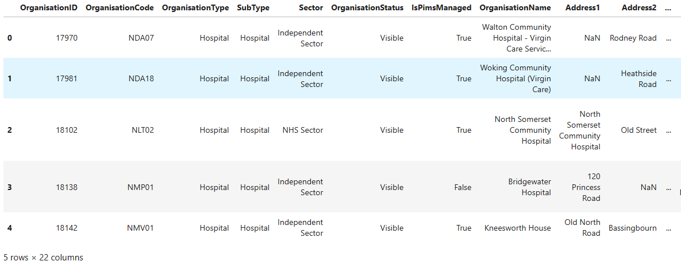

Slide 12
Check for Missing Values
Check for missing values in the dataset by using functions like isnull() in Pandas, which returns a boolean DataFrame indicating the presence of missing values. Summarize the total count of missing values for each column to identify which variables need attention for data cleaning.

Slide 13
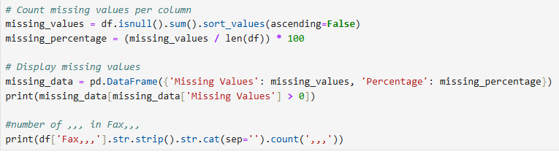
Check for Missing Values

Slide 14
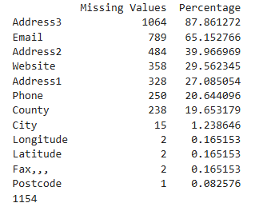
Check for Missing Values

Slide 15
Handle Missing Values
Handle missing values by deciding on an appropriate strategy, such as imputing missing values with the mean, median, or mode, depending on the data type and distribution. Alternatively, you can drop rows or columns with excessive missing data using dropna() in Pandas to ensure the dataset remains robust for analysis.

Slide 16
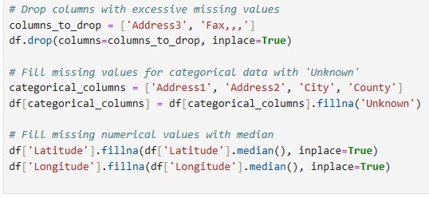
Handle Missing Values

Slide 17
Check for Duplicates and Remove Them
Check for duplicates in the dataset using the duplicated() function in Pandas, which identifies any rows that are exact copies of others. To ensure data integrity, remove these duplicate entries by applying the drop_duplicates() function, keeping only unique records necessary for accurate analysis.

Slide 18
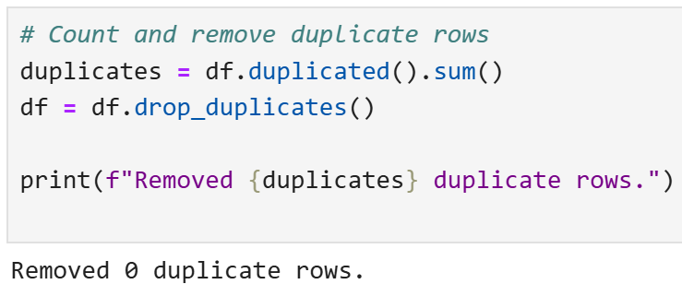
Check for Duplicates and Remove Them

Slide 19
Standardize Phone and Website Formats
Standardize phone and website formats by applying string manipulation techniques to ensure uniformity in data representation. For phone numbers, convert them to a common format using regular expressions to remove special characters and enforce a consistent international dialing format. For websites, ensure that all URLs are corrected to include the proper scheme (http:// or https://) and are free of unnecessary parameters or trailing slashes.

Slide 20
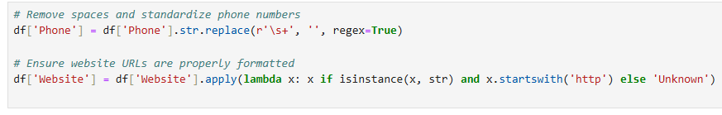
Standardize Phone and Website Formats

Slide 21
Save the cleaned data
Save the cleaned data by using the to_csv() function in Pandas, specifying the desired file path and name. Ensure to set parameters like index=False to avoid saving the DataFrame index as a separate column. This step allows for easy retrieval and use of the cleaned dataset for future analysis or reporting.

Slide 22
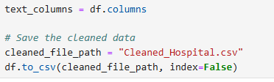
Save the cleaned data

Slide 23
Exploratory Data Analysis (EDA)
Distribution of Hospital Types Geographic Distribution of Hospitals Top 10 Cities with the Most Hospitals Public vs Private Hospitals

Slide 24
Distribution of Hospital Types
Analyze the distribution of hospital types by categorizing hospitals into various classifications such as public, private, non-profit, and for-profit. Use visualizations like bar charts or pie charts to illustrate the percentage of each type, allowing stakeholders to understand the composition of the healthcare system and identify trends or disparities in hospital availability.

Slide 25
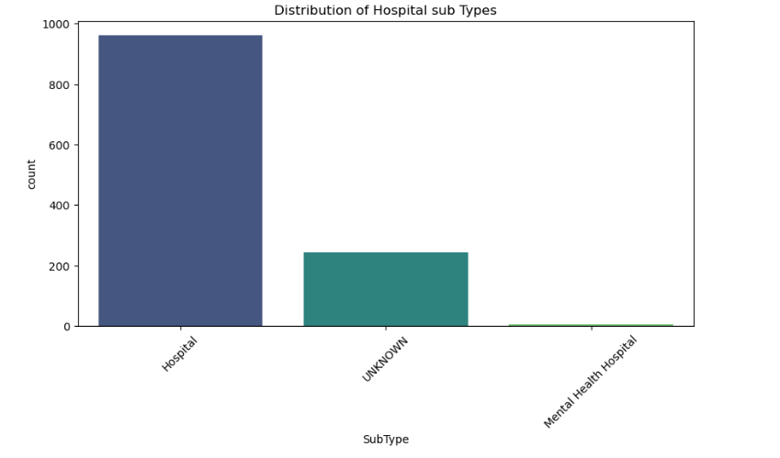
Distribution of Hospital Types

Slide 26
Distribution of Hospital Types
The count plot shows that 'Hospital' is the predominant SubType, followed by 'UNKNOWN' and then 'Mental Health Hospital'. This indicates that the dataset primarily focuses on general hospitals rather than other sub types. It also indicates that there are many entries where the sub type is unknown. This should be considered in further analyses, as it might skew results if not accounted for.

Slide 27
Geographic Distribution of Hospitals
Examine the geographic distribution of hospitals by mapping their locations across different regions. This can be done using geospatial analysis tools or libraries such as Folium or Geopandas. Visualizing hospital locations in relation to population density, regional healthcare needs, and accessibility can highlight areas that may require additional medical facilities or resources.

Slide 28
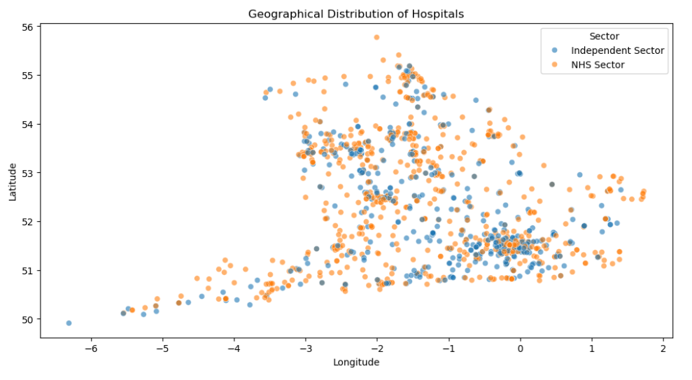
Geographic Distribution of Hospitals

Slide 29
Geographic Distribution of Hospitals
The scatter plot reveals a concentration of hospitals in certain areas, particularly in the southern regions of the UK. Both NHS Sector and Independent Sector hospitals are distributed throughout the region, but there might be local clusters of one sector or the other. Further analysis could explore the reasons behind these clusters and their implications for healthcare access.

Slide 30
Top 10 Cities with the Most Hospitals
Identify the top 10 cities with the most hospitals by aggregating data based on the number of healthcare facilities within each city. This analysis can help inform healthcare policy decisions and resource allocation. Moreover, visual representations such as bar charts can effectively communicate which cities lead in hospital availability, assisting in understanding urban healthcare distribution.

Slide 31
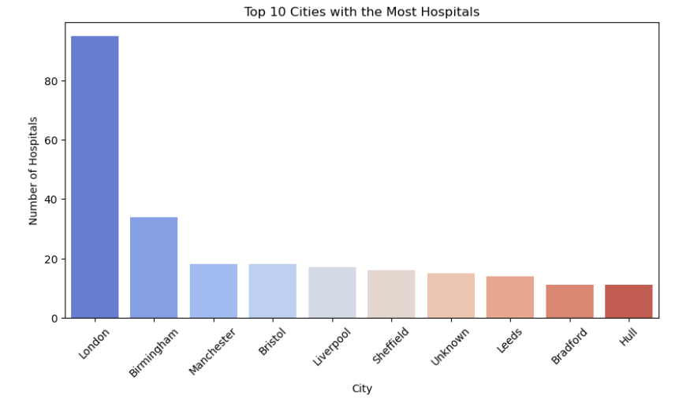
Top 10 Cities with the Most Hospitals

Slide 32
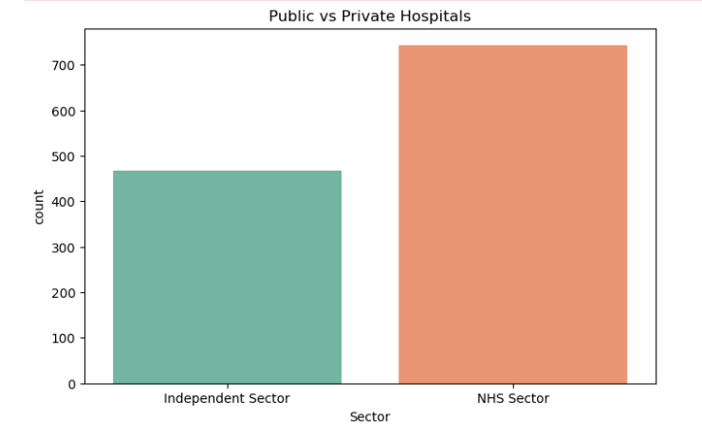
Public vs Private Hospitals

Slide 33
Advanced Data Analysis
Number of Hospitals by Region (City, County) Percentage of Hospitals Managed by NHS vs Independent Sector Completeness of Contact Information Geographic Coverage - Number of Hospitals per Latitude/Longitude

Slide 34
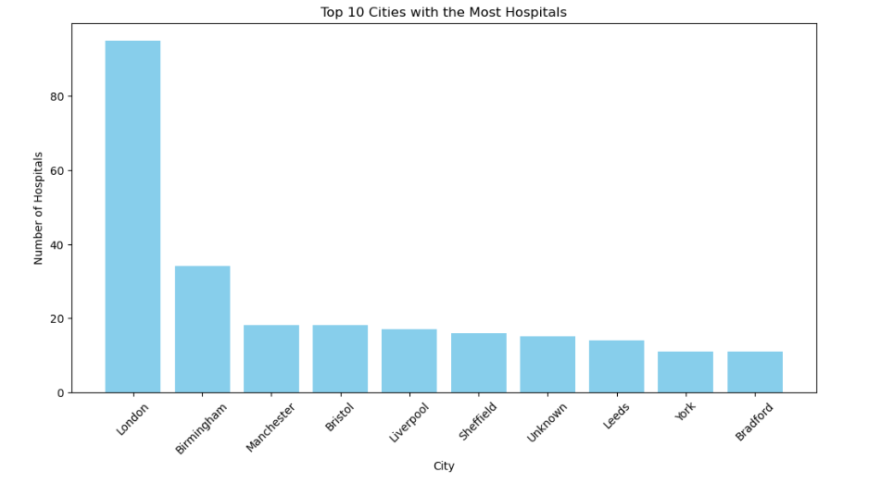
Number of Hospitals by City

Slide 35
Number of Hospitals by City
The bar plot clearly shows that London has a significantly higher number of hospitals compared to other cities. This concentration of hospitals in London likely reflects its larger population and status as a major metropolitan area. Other major cities like Birmingham, Manchester, and Bristol also have a notable number of hospitals.

Slide 36
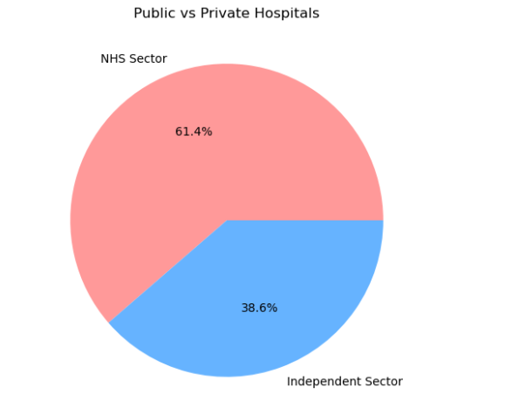
Percentage of Hospitals Managed by NHS vs Independent Sector
The pie chart clearly illustrates that the NHS Sector represents a larger proportion (61.4%) of hospitals compared to the Independent Sector (38.6%). This visual representation emphasizes the dominance of public healthcare provision in the dataset

Slide 37
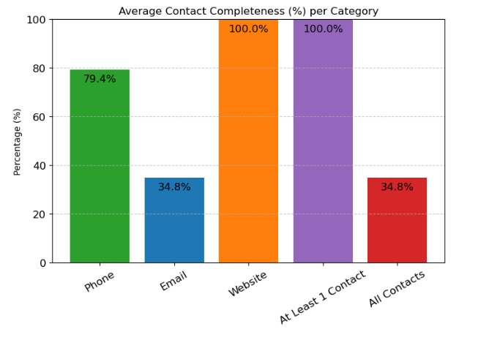
Completeness of Contact Information

Slide 38
Geographic Coverage - Number of Hospitals per Latitude/Longitude

Slide 39
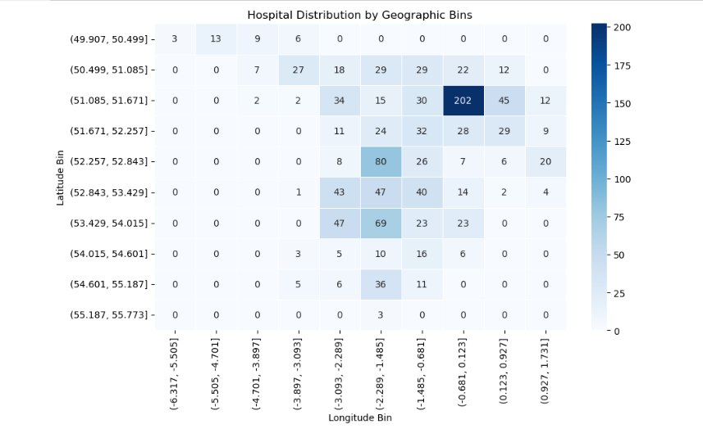

Slide 40
The heatmap shows a clear concentration of hospitals in the bin centered around latitude 51.085 to 51.671 and longitude -1.485 to -0.681. This bin has a significantly higher number of hospitals (202) compared to all other bins, indicated by the darkest shade of blue. This region likely corresponds to a major metropolitan area, possibly London or its immediate surroundings.
Several other bins, particularly those in the middle latitudes and longitudes, also show a moderate number of hospitals, suggesting a broader distribution of healthcare facilities across certain regions.

Slide 41
Dashboard

Slide 42
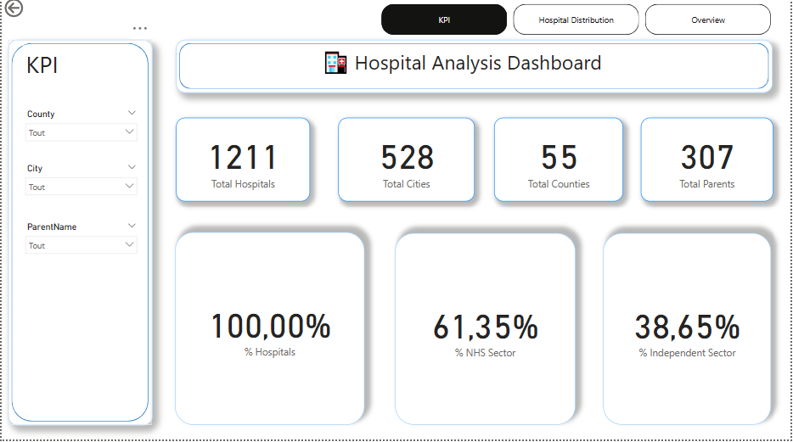
Dashboard

Slide 43
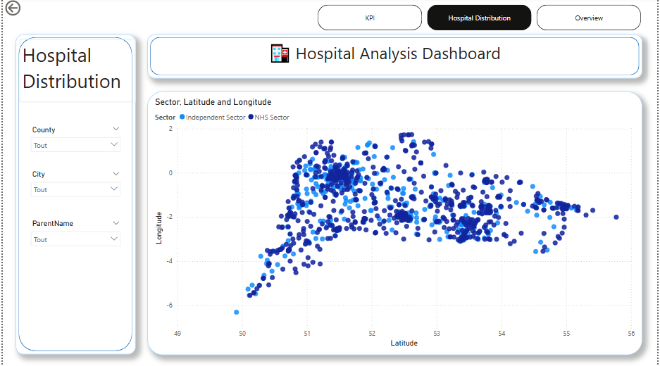
Dashboard

Slide 44
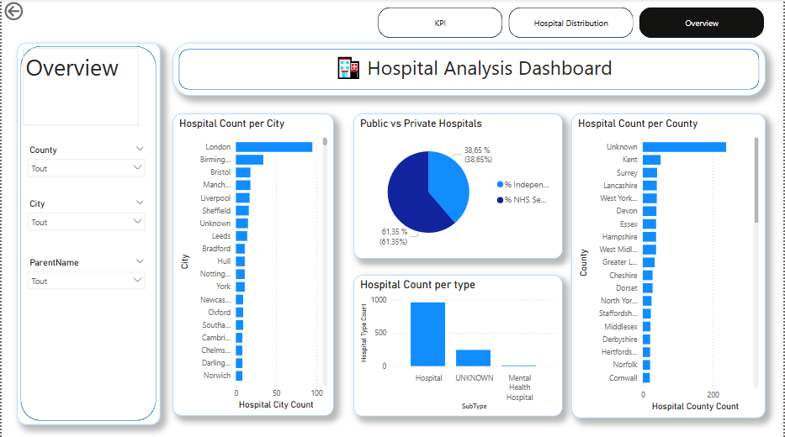
Dashboard

Slide 45
Strategic Recommendations
Geographic Disparities: Allocate resources to underserved areas (heatmap shows uneven distribution).
Explanation: The heatmap visualization clearly indicates that hospitals are not evenly distributed across the region. Some areas have a high concentration, while others are sparsely served. To ensure equitable access to healthcare, resources should be directed towards developing facilities or enhancing services in the underserved regions.
Data Completeness: Improve email data capture for better communication (34.8% completeness).
Explanation: The analysis revealed that only a small percentage of hospitals have complete email contact information. This limits the potential for efficient digital communication with patients, other providers, and administrative bodies. Efforts should be made to improve the collection and maintenance of email data.

Slide 46
Strategic Recommendations
Service Planning: Prioritize general hospitals, but address mental health needs (dominant types).
Explanation: The data shows that "Hospital" is the most common type, indicating a prevalence of general hospitals. However, "Mental Health Hospital" also appears as a significant subtype. Therefore, service planning should prioritize general healthcare needs while also ensuring adequate resources and facilities for mental health services.
Sector Balance: Consider both NHS (61.4%) & Independent (38.6%) sectors in policy.
Explanation: The analysis of hospital sector shows that both the NHS and Independent sectors contribute substantially to healthcare provision. Healthcare policies and funding models should consider the roles and interactions of both sectors to optimize overall healthcare delivery.

Slide 47
Strategic Recommendations
Parent Organizations: Monitor large organizations' influence (concentration of hospitals).
Explanation: The analysis of parent organizations reveals that a few large entities control a significant number of hospitals. It is important to monitor the influence of these organizations to ensure fair competition, prevent monopolies, and protect patient interests.

Slide 48
Conclusion
This presentation has shown key trends in hospital data, including geographic concentrations, sector distribution, and organizational influences. These findings are crucial for informed healthcare planning and resource allocation.

Slide 49
Thank you!

